Slide 1
Lab 2: Exploring Data with Graphical Displays and Numerical Summaries “Got Data”
STAT 201: Elementary Statistics
Shan Zhong

Slide 2
Introduction to the lab
The purpose of this lab is to get familiar with working with the data in StatCrunch.
This lab illustrates how software can be used to work with large amounts of data.
We are going to be working with the data that has been created from the survey that all 201 students were asked to complete.
We are going to use this data to create graphs and make observations from these graphs.
Table 2.1 is a good reference for which types of graphs can be used with each type of data (categorical vs quantitative).
We are going to create numerical summaries using this data.
Table 2.1 is a good reference for which types of numerical summaries can be used with each type of data (categorical vs quantitative).

Slide 3
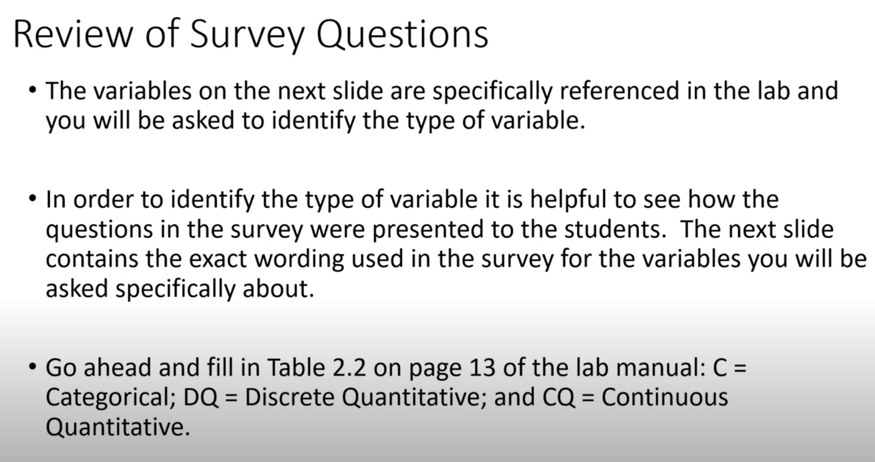

Slide 4
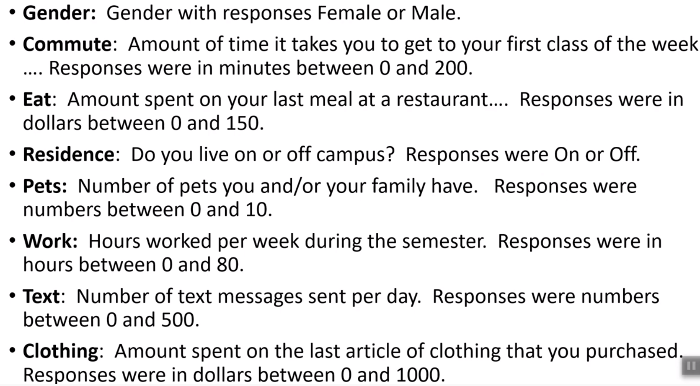

Slide 5
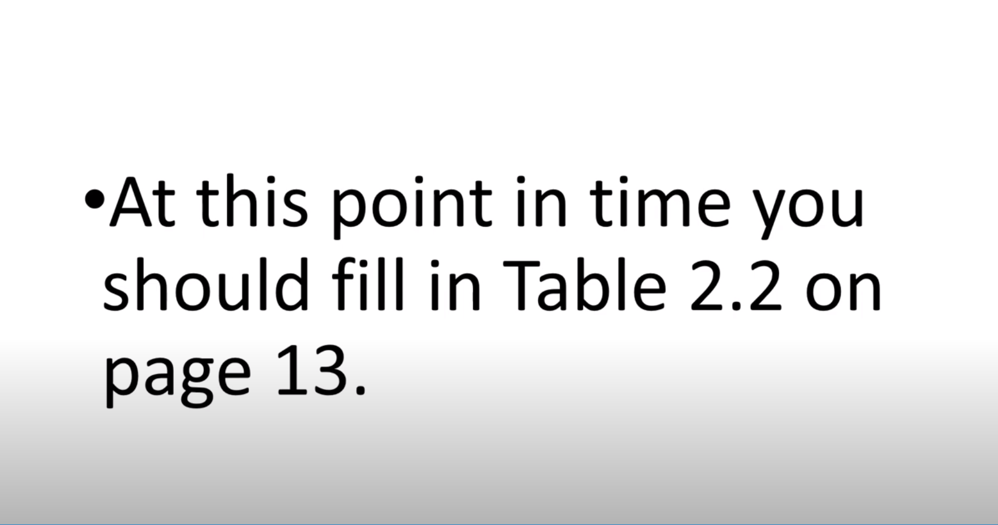

Slide 6
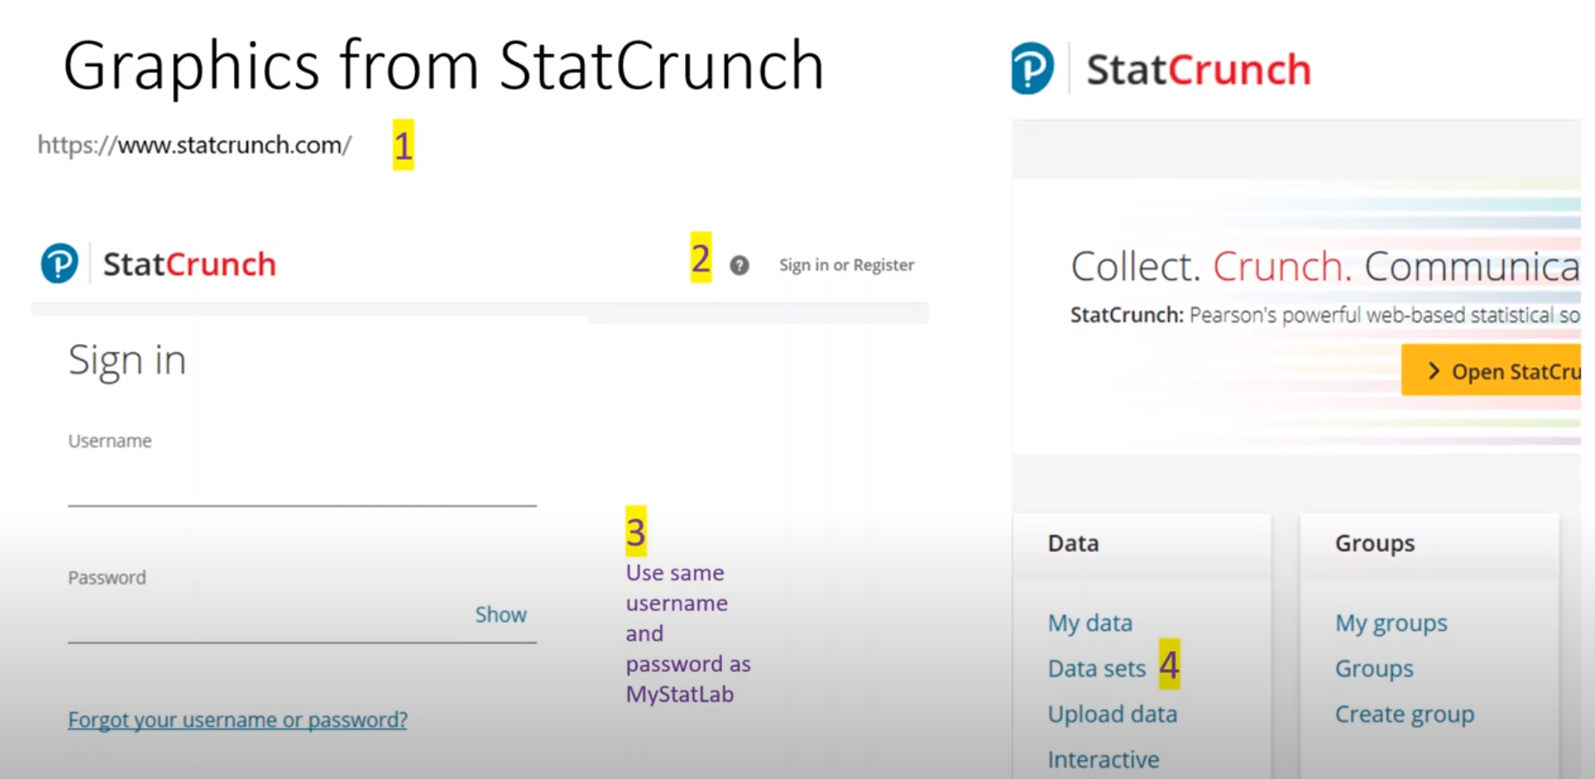
Steps for Lab 2
Log on to the computer.
Go to StatCrunch.com: (Explore -> Data -> 201 Spring 2021 Murphy )
www.statcrunch.com

Slide 7
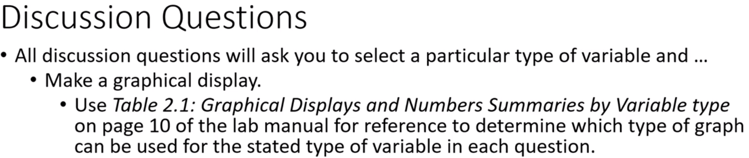
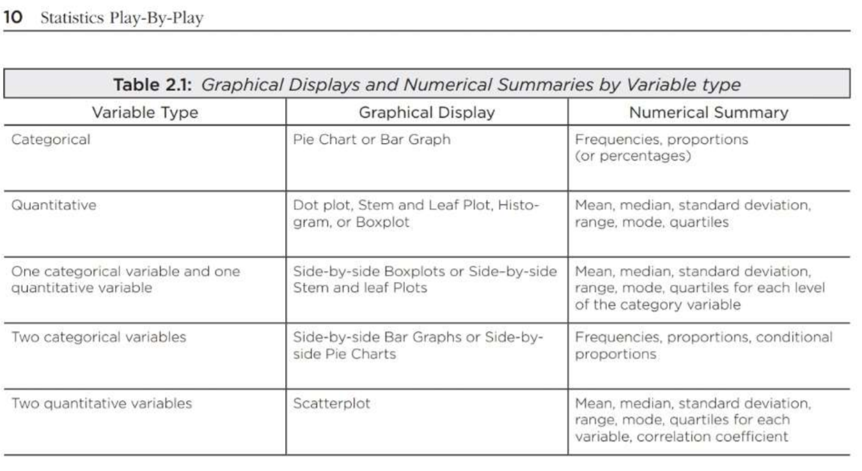
Use Group by
option

Slide 8
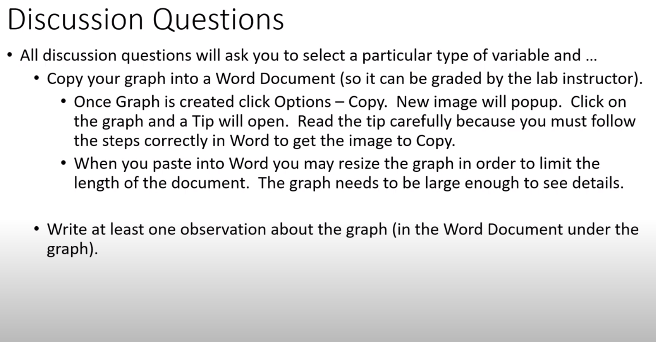

Slide 9
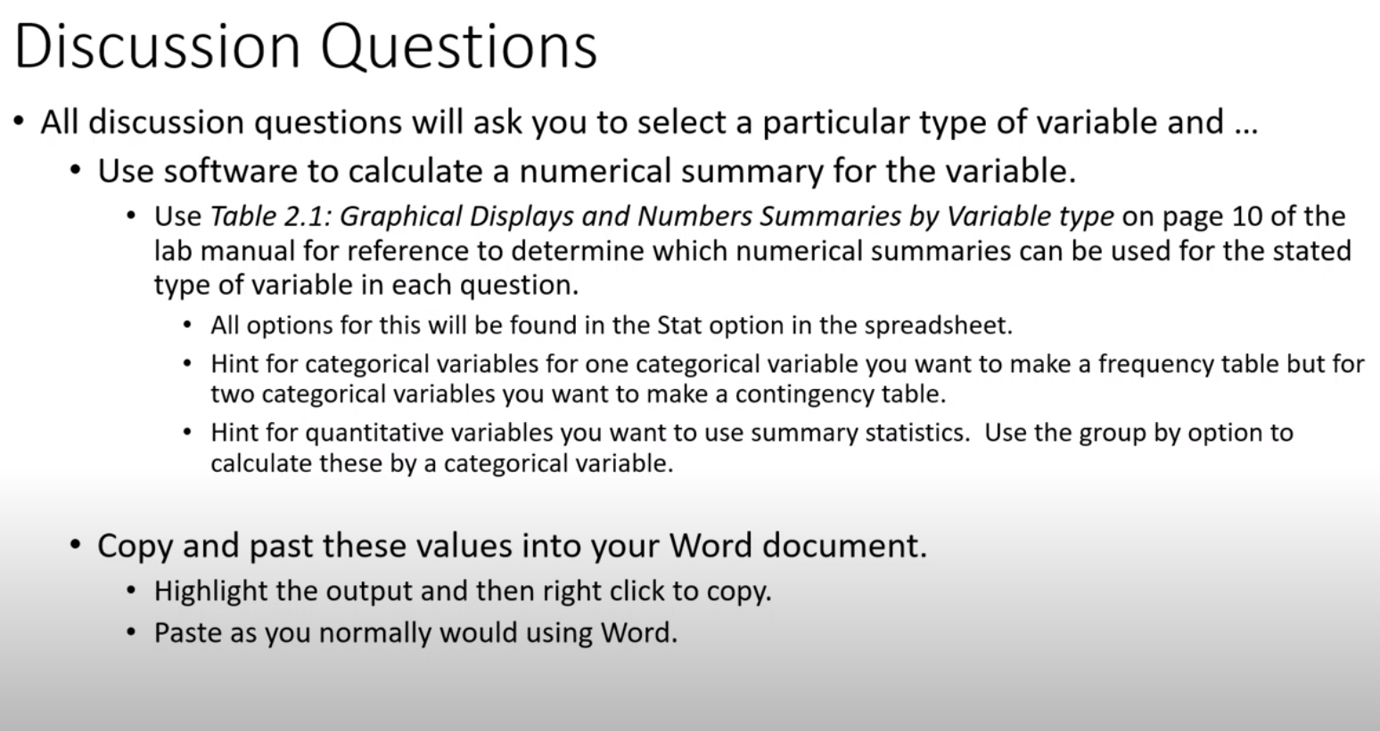

Slide 10
